Slide 1
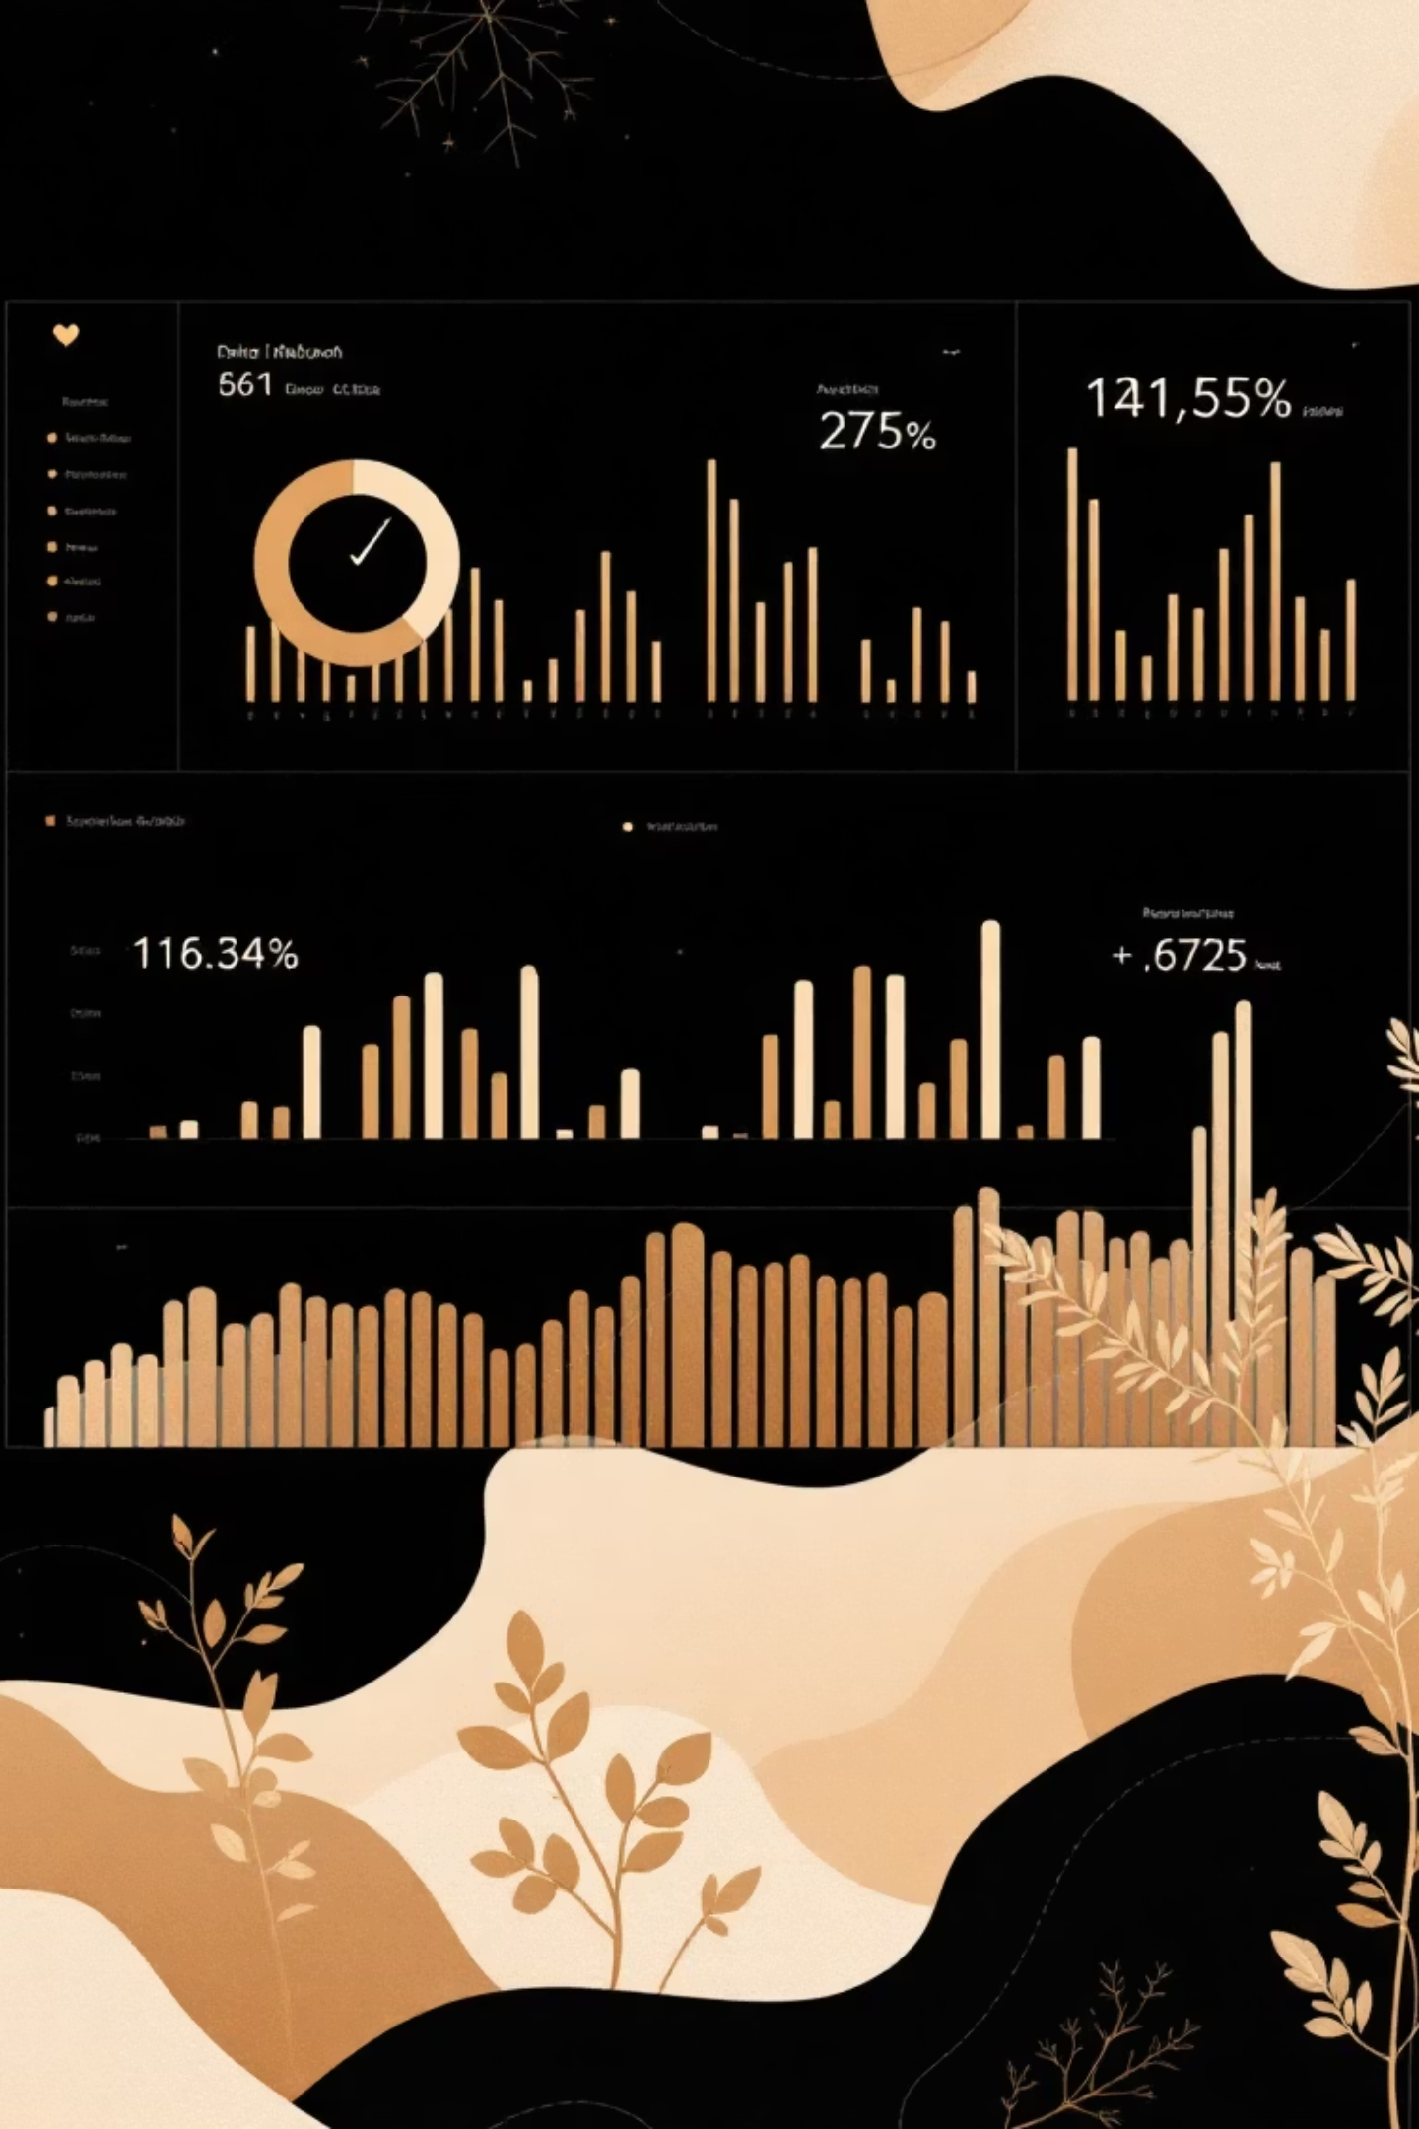
Customer Shopping Behavior & Sales Analysis
Uncovering insights from 3,900+ purchases to drive data-driven business decisions

Slide 2
PROJECT SCOPE
Dataset Overview
3,900
18
37
Total Records
Variables
Missing Values
Transactions analyzed across multiple categories
Demographics, purchases, behavior metrics
Identified in Review Rating column
Customer Data
Transaction Data
Age, Gender, Location
Product Category & Item
Subscription Status
Purchase Amount & Season
Purchase Frequency
Discounts & Promo Codes

Slide 3

PYTHON
Data Preparation & Cleaning
01
02
03
Data Loading & Exploration
Missing Data Handling
Standardization
Imported dataset, verified structure with df.head(), df.info(), df.describe()
Imputed Review Rating nulls using median rating per product category
Renamed columns to snake_case, removed redundant promo_code_used field
04
05
Feature Engineering
Database Integration
Created age_group bins and purchase_frequency_days metrics
Connected to MySQL and loaded cleaned data for SQL analysis

Slide 4
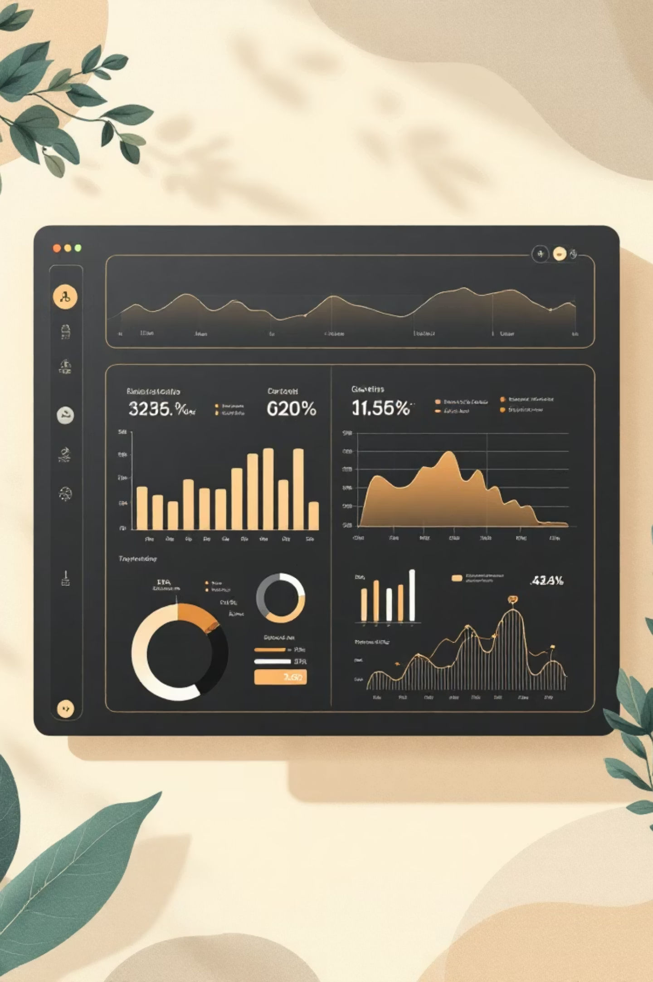
SQL ANALYSIS
Key Performance Indicators
Total Revenue
233,081
Comprehensive sales performance tracking
Total Customers
3,900
Active customer base measurement
Average Review Rating
3.75
Customer satisfaction metrics
Average Order Value
$59.76
Boosts Revenue & Profitability
Average Previous Purchase
25.35
Enhanced Customer Insights

Slide 5


Sales Performance Insights
Category-wise Sales
Revenue by Season
Clothing leads revenue generation across all product categories
Seasonal trends show peak shopping periods and demand fluctuations
Subscription Impact
Discount Effect
Non-Subscribers generate higher revenue vs subscribers
Discounts drive volume but impact margins

Slide 6




Customer Behavior Patterns
Payment Preferences
Credit cards dominate as the most used payment method across all transactions
Gender Revenue Split
Male vs female customer spending reveals distinct purchasing patterns
Shipping Choices
Express shipping users show higher average purchase amounts than standard

Slide 7

PRODUCT ANALYSIS
Top Performing Products
Highest Rated Items
Top 5 products with exceptional customer reviews drive satisfaction and repeat purchases
Discount Leaders
5 products with highest discount usage rates show promotional effectiveness
Category Champions
Top 3 most purchased items within each category reveal customer preferences

Slide 8






Customer Segmentation
Loyal
Returning
New
Customers segmented by previous purchase history: New (0-1), Returning (2-9), Loyal (10+)
Subscription Correlation
Age Group Revenue
Repeat buyers (5+ purchases) show strong likelihood to subscribe
Different age segments contribute varying revenue levels

Slide 9
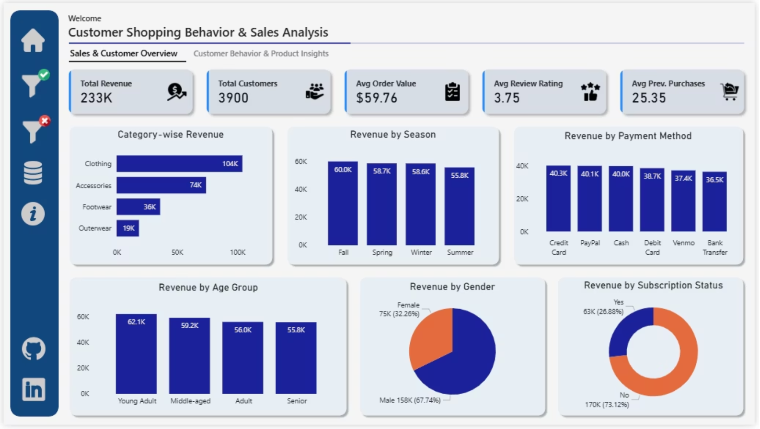
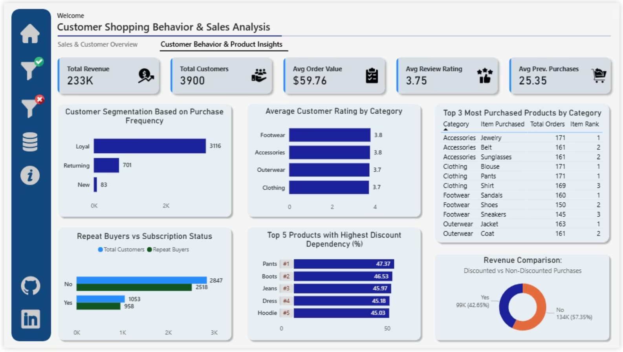
POWER BI
Interactive Dashboard
Two-page Power BI dashboard visualizes key insights for stakeholder decision-making.
Page 1: Sales & Customer Overview
Page 2: Customer Behavior & Product Insights
Revenue trends, customer demographics, subscription analysis, seasonal patterns
Purchase patterns, product performance, discount impact, loyalty segmentation

Slide 10


Strategic Recommendations
Boost Subscriptions
Loyalty Programs
Promote exclusive benefits to increase customer lifetime value
Reward repeat buyers to transition into Loyal segment
Review Discounts
Targeted Marketing
Balance short-term sales with long-term margin control
Focus on high-revenue age groups and express-shipping users
Business Impact
✔ Improved customer engagement
✔ Higher retention & repeat purchase rate
✔ Optimized promotional spend
✔ Stronger revenue predictability

